Slide 1
Coffee Quality Analysis
BY HARSHA
Notes:
© Copyright PresentationGO.com – Free Templates & Infographics for PowerPoint and Google Slides

Slide 2
PROJECT OVERVIEW
The primary objective of this project is to conduct a comprehensive analysis to understand the factors that contribute to Coffee quality and improve overall Quality of Coffee.
By systematically evaluating various parameters such as flavor, aroma, Body, consistency etc., the project aims to identify key factors influencing coffee quality.
The analysis will provide insights into optimizing Variety of Coffees ng Methods etc., and meeting customer expectations
Notes:
© Copyright PresentationGO.com – Free Templates & Infographics for PowerPoint and Google Slides

Slide 3
Business Objective and Constraints :
The Coffee Quality Institute (CQI) is a non-profit organization that works to improve the quality and value of coffee worldwide.
It was founded in 1996 and has its headquarters in California, USA. The organization works with coffee growers, processors, roasters, and other stakeholders to improve Coffee quality standards, promote sustainability, and support the development of the specialty cofred
Notes:
© Copyright PresentationGO.com – Free Templates & Infographics for PowerPoint and Google Slides

Slide 4

Technical Stacks :
Notes:
© Copyright PresentationGO.com – Free Templates & Infographics for PowerPoint and Google Slides

Slide 5
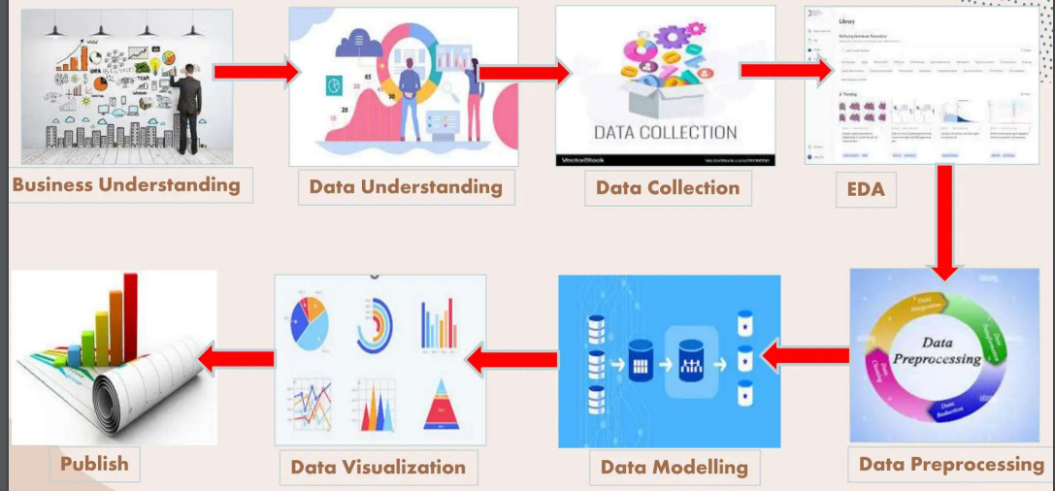
Project Architecture :
Notes:
© Copyright PresentationGO.com – Free Templates & Infographics for PowerPoint and Google Slides

Slide 6
Exploratory Data Analysis:
Data:
The data includes a range of information on coffee production, processing, and sensory evaluation. It also contains data on coffee genetics, soil types, and other factors that can affect coffee quality.
Sensory evaluations (coffee quality scores)
Aroma: Refers to the scent or fragrance of the coffee.
Flavor: The flavor of coffee is evaluated based on the taste, including any sweetness, bitterness, acidity, and other flavor notes.
Aftertaste: Refers to the lingering taste that remains in the mouth after swallowing the coffee.
Acidity: Acidity in coffee refers to the brightness or liveliness of the taste.
Body: The body of coffee refers to the thickness or viscosity of the coffee in the mouth.
Balance: Balance refers to how well the different flavor components of the coffee work together.
Uniformity: Uniformity refers to the consistency of the coffee from cup to cup.
Clean Cup: A clean cup refers to a coffee that is free of any off-flavors or defects, such as sourness, mustiness, or staleness.
Sweetness: It can be described as caramel-like, fruity, or floral, and is a desirable quality in coffee.

Slide 7
Data Pre Processing in Power Query Editor:
Country Of Origin - Renamed to Country
Lot Number - replaced null with fill down. Converted Chinese to english
Altitude - Splitted twice & created columns. One delimiter column deleted. Converted datatype to number. –Only one blank in Altitude.1, replaced blank to null, 1 blank filled with fill down. -Datatype to whole number for both columns -Created a new column with condition calculating average of range, if there is a range in altitude.
Region - Removed Empty, So 207 rows to 205. 2 Rows deleted. Replace Chinese language words to English for Consistency
Number of Bags - Clear
Bag Weight - Extracted kg from Weight & converted to Whole Number.
In-Country Partner - Replaced Chinese words to English
Grading Date - Replaced st, th, st, nd with space, Augu to August & change type to Date.
Variety - Replace blank to null, Fill Down the null Also there were unknow & unknown rows, but from Country Taiwan only.
Processing Method - Replace blank to null, Fill Down the null
11. Color - Replaced the text corrections
12. Expiration: Replaced corrections & change type to Date. Tata Tre Processing Ther 19
13. Remaining all the columns are clear with no errors.

Slide 8


Slide 9
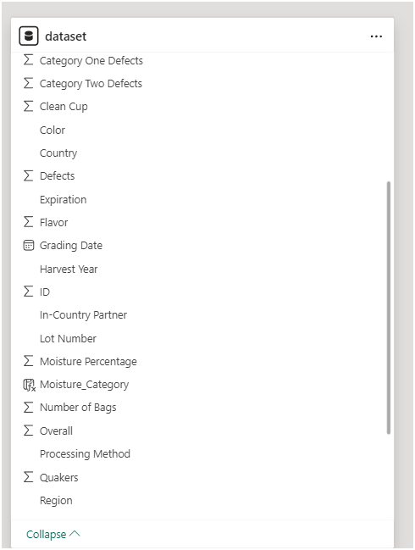

Slide 10


Slide 11
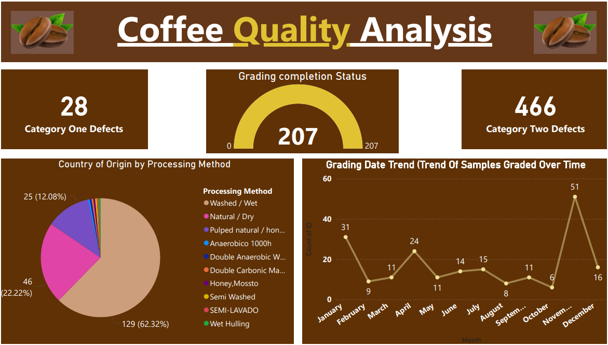

Slide 12
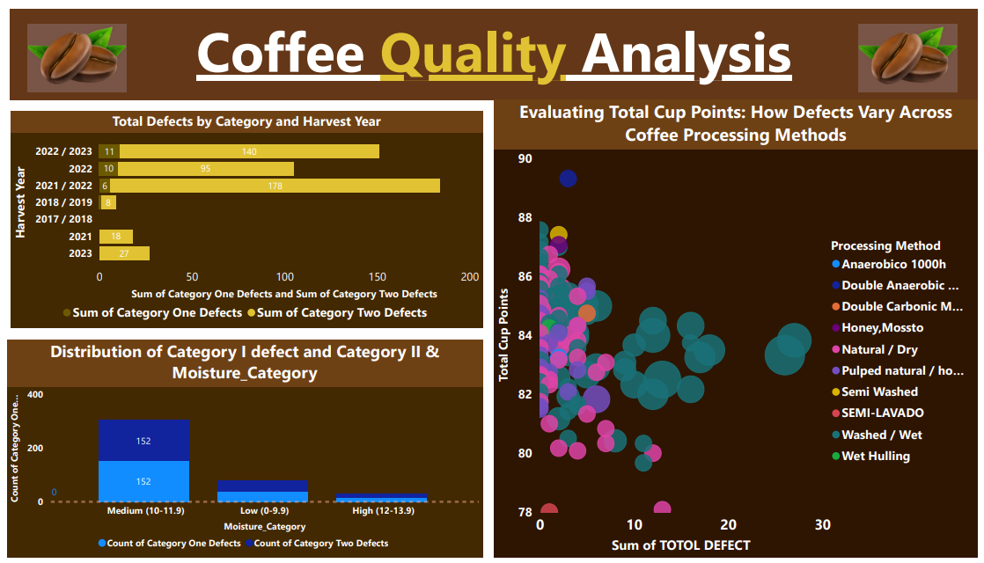

Slide 13
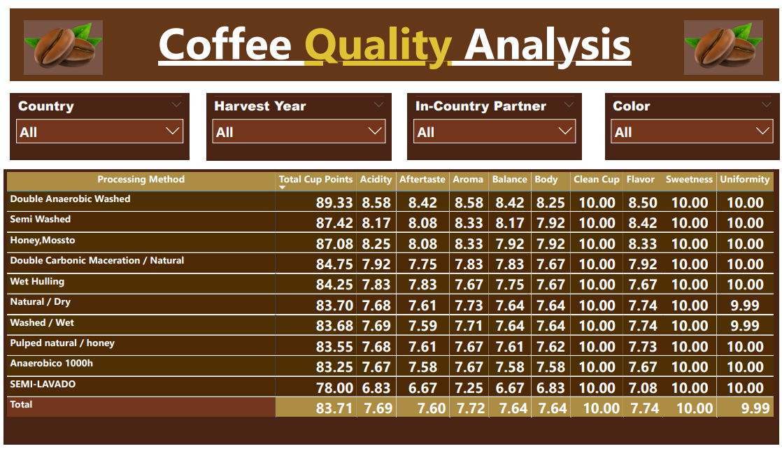

Slide 15
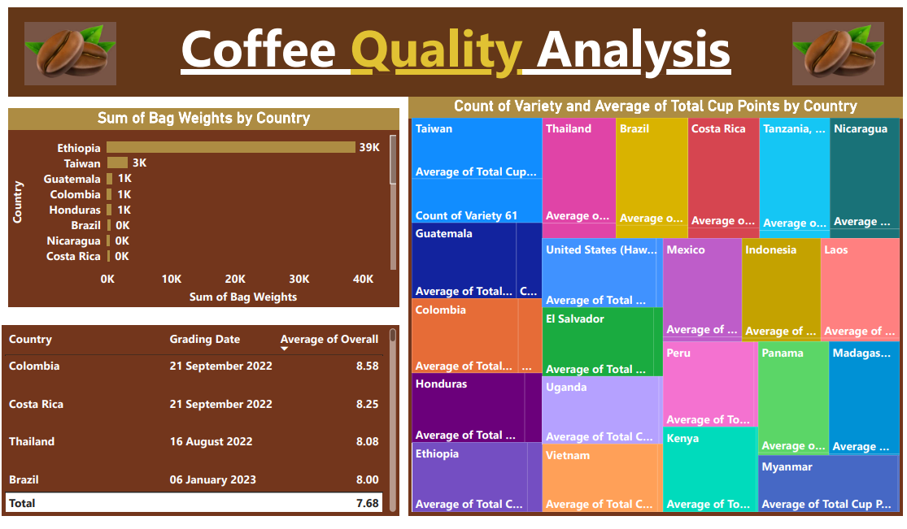
Exploratory Data Analysis:

Slide 16
Insights Outcome of Project

Slide 17
Insights:
What are the key determinants of coffee quality as evaluated through sensory attributes such as aroma, flavor, acidity, etc.?
Aroma, flavor, Acidity, Body are the key attributes that impacts Coffee Quality much. Castillo, Redbourn varieties are the top two Coffee Qualities.
Is there a correlation between processing methods, origin regions, and coffee quality scores?
The processing method impacts the coffee Bean attributes such as Acidity, Aromа, Воdу, Balance. Regions in high Altitude produces Good Quality of Coffee Beans.

Slide 18
Insights:
Can we identify any trends or patterns in defect occurrences and their impact on overall coffee quality?
Category 2 defects are more compared to category 1 defects.
Washed/Wet processed beans has more defects.
November, April & March Graded Beans has more defects.

Slide 19
Insights:
How do different variables interact to influence the Total Cup Points, which represent an overall measure of coffee quality?
The Overall Cup points of a Coffee is influenced by attributes Acidity, flavor, Aroma, Воду, Balance, After taste. The increase in this attributes enhances the Coffee Quality Points. \
Beans Processed with Double Anaerobic washed, Semi washed &Honey/Mossto methods has high Cup Points.
Castillo, Red Bourbon & Sl34+Gesha are top 3 Quality Beans when compared to Cup Points.
Ethiopia, Tanzania, Taiwan, Gautemela, Madagasarcar are the top 5 Countries.

Slide 20
Thank You!
Notes:
© Copyright PresentationGO.com – Free Templates & Infographics for PowerPoint and Google Slides

